Slide 1


ScholarSHPE 101 Workshop
Learn about how to apply to scholarships and how to put together a winning essay!
October 27, 2022
7-8pm CST
Questions? Ask Daniela Gonzalez
SHPE Houston Scholarship Coordinator
scholarship@shpehouston.org

Slide 2
ScholarSHPE Workshop
October 27, 2022
Daniela Gonzalez
SHPE Houston Scholarship Coordinator

Slide 3
Scholarships

Slide 4

What Are the Types of Financial Aid?
Scholarships | Does not have to be repaid Can be offered from institutions or outside organizations You should never have to pay to do a scholarship search - beware of scams
Grants | Does not have to be repaid Awarded based on financial need and/or academic achievement Some are federally funded and others are state programs Some institutions have private grant programs
Federal Work-Study Program | Based on financial need Allows students to earn income working part-time Can work either on or off campus
Loans | Must be repaid Federally funded Privately funded from lenders such as banks and credit unions Credit based

Slide 5
What are Scholarships and what are the Types?
Scholarships are:
• One-time vs Renewable
• Outside vs. school-based
• Merit vs need, or both
• Payable to you or to your institution, or both
• Do not have to be paid back
• May carry requirements around:
– Use of award
– Reporting progress/attending events
– Minimum GPA
Notes:
Scholarships are financial awards to help students pay for college

Slide 6

Applying for Scholarships
Make sure you understand the conditions you must meet to keep your scholarship
Cast your net wide
• Do NOT ignore local scholarships
– Look for opportunities in your community, district, school, etc
– No scholarship is too small!
– May be less competitive
• Be original in your responses
• Apply for as many as you can
• Do not spend money to apply for scholarships
– You should never pay for a scholarship search engine

Slide 7
When to Apply?
Continual process – you should begin your scholarship search before
your Senior year in high school; preferably your Junior year in high school
– Many scholarships applications will require essays. Feel free to draft a
few “core” essays that you can refer back to and edit as needed
Good rule of thumb → Start applying no later than 6 months before you
need the funding
– Between January and May for funding in the fall semester
– Between May and October for spring semester funding

Slide 8
Application Tips
Read Directions Carefully
Common Mistake - Items are missed
Solution - Before turning in your application have a parent or friend read over the directions to double check you have everything.
Deadlines
Common Mistake - Waiting until days before the deadline to ask for a required letter of rec. Or turning in your application after the deadline.
Solution - Use a planner or other device to plan ahead and turn in scholarship a day or two early just to be safe.
Make Your Application Look Professional
Common Mistake - Hand written / crinkled pages. Looks like you rushed through it.
Solution - Type materials whenever possible. Proofread written work. If you want hundreds/thousands of dollars make it look like a million bucks.

Slide 9
Application Tips
Organizations want to get to know you as a person. Let them know what you’re thinking.
There’s a time to be humble, but when someone is asking what you’ve done speak up about it.
Quality over quantity. It’s not how many clubs, organizations you are involved it’s the experiences you have in them that make the difference. (ex. MIT limits their applications to 4 activities)
For essays don’t just regurgitate activities you listed. Share an experience or something else that is specific to the prompt.

Slide 10
Where to Apply for Scholarships
Keep a Google Spreadsheet handy with links to resources and set up reminders for yourself to apply
• HSF.net
• Scholarships.com
• Cappex.com
• Fastweb.com
• Collegeboard.org
• Latinocollegedollars.org
• Univision.com
• College Greelight
• College Xpress (collegexpress.com)
• Naviance
• Peer lift
• E4FC.org (for DACA/undocumented students)
• Dreamer Roadmap
QuestBridge.org
Notes:
Check out other school district websites

Slide 11
Use Google Sheets to Track Scholarship Applications
https://docs.google.com/spreadsheets/d/1b_VXLSzdVby0uc-3IZmvbWkzg4r-qr3HU0FB4JNouyc/htmlview#
https://sites.google.com/bcsemail.org/college-application-planning-2/scholarships
https://docs.google.com/spreadsheets/d/14n_4r4et47QEDm6tL4vjVT13dp6s7-5UkNie5PBTG2c/edit#gid=0

Slide 12
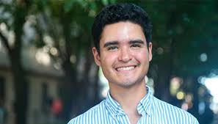
Tips for Undocumented Students
You can attend college!
• Ask colleges about their undocumented student policy
• In some states, undocumented students, or specifically DACA students, are eligible to receive in-state tuition
• You may be eligible for state grant programs
• Search for private scholarship opportunities
• We recommend that you check with your high school counselor or
your college or career school financial aid office to see what types of
financial aid you may be eligible to receive and whether completing
the FAFSA is the way to apply for that aid
1st Latino DACA Rhodes Scholar!

Slide 13




Scholarships + College Student = Potential Internship
A lot of times companies will sponsor scholarship organizations and can have your resume readily available to provide to recruiters!
Professional societies can also be a good resource and may have programs:
• American Chemical Society - ACS Scholars Program
• Society of Women Engineers
• MALDEF - Mexican American Legal Defense and Educational Fund

Slide 14

https://docs.google.com/forms/d/1UyjFqJAqz0jyRReDZ-tT-Yl6u2YFAWo6pRGWuyoX2Bk/edit

Slide 15
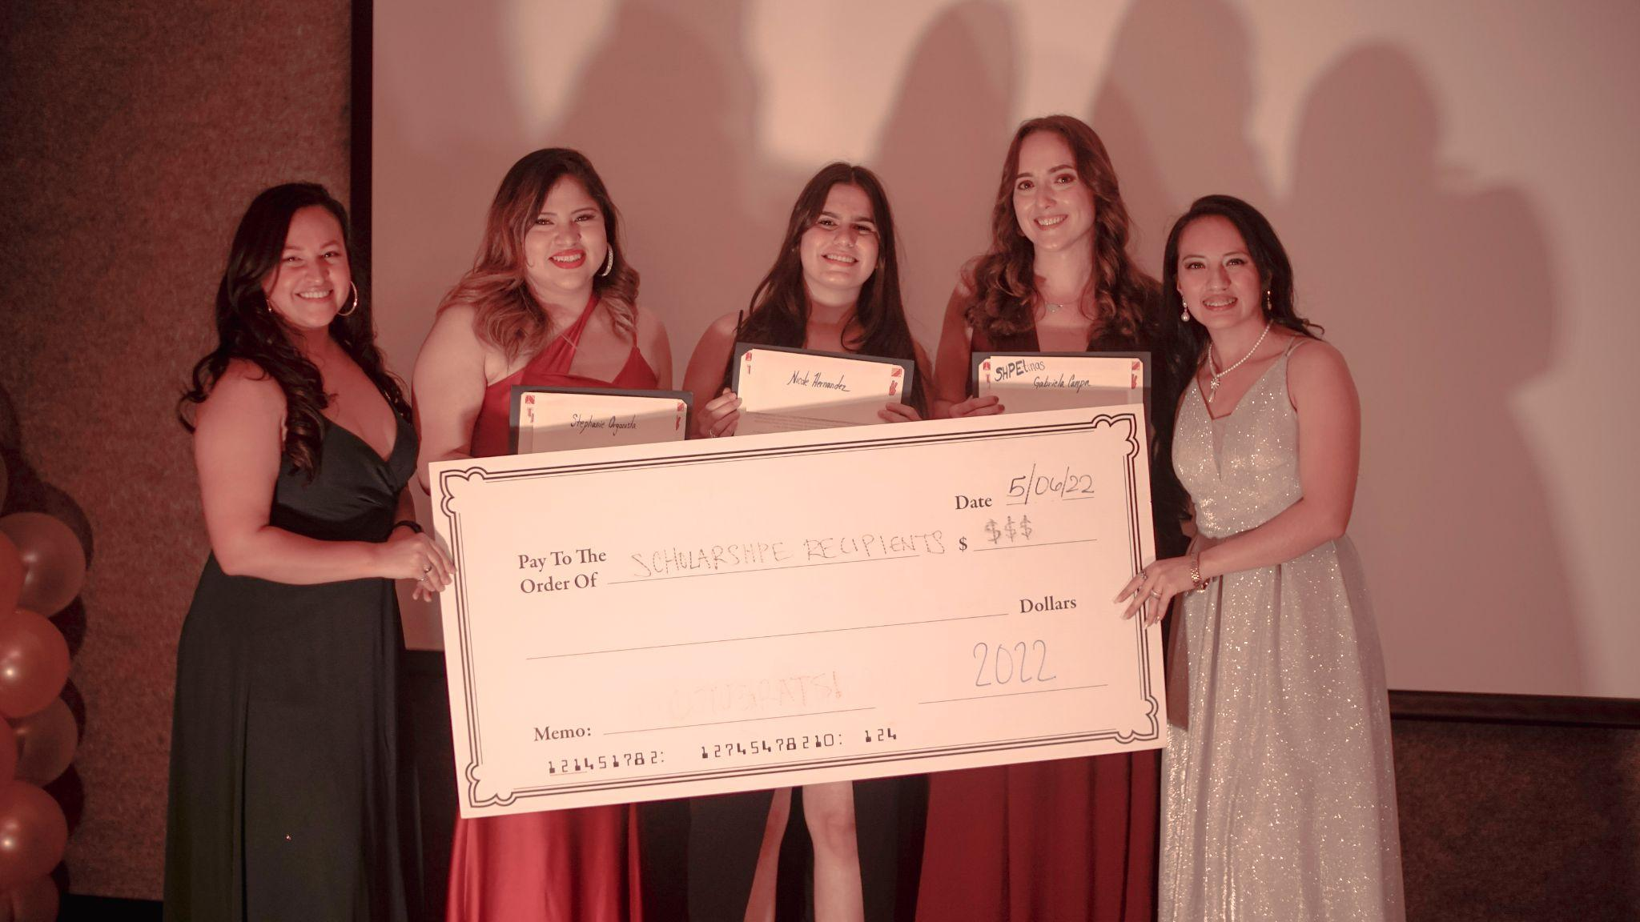
Spotlight
2021-2022
Scholarship Recipients

Slide 16
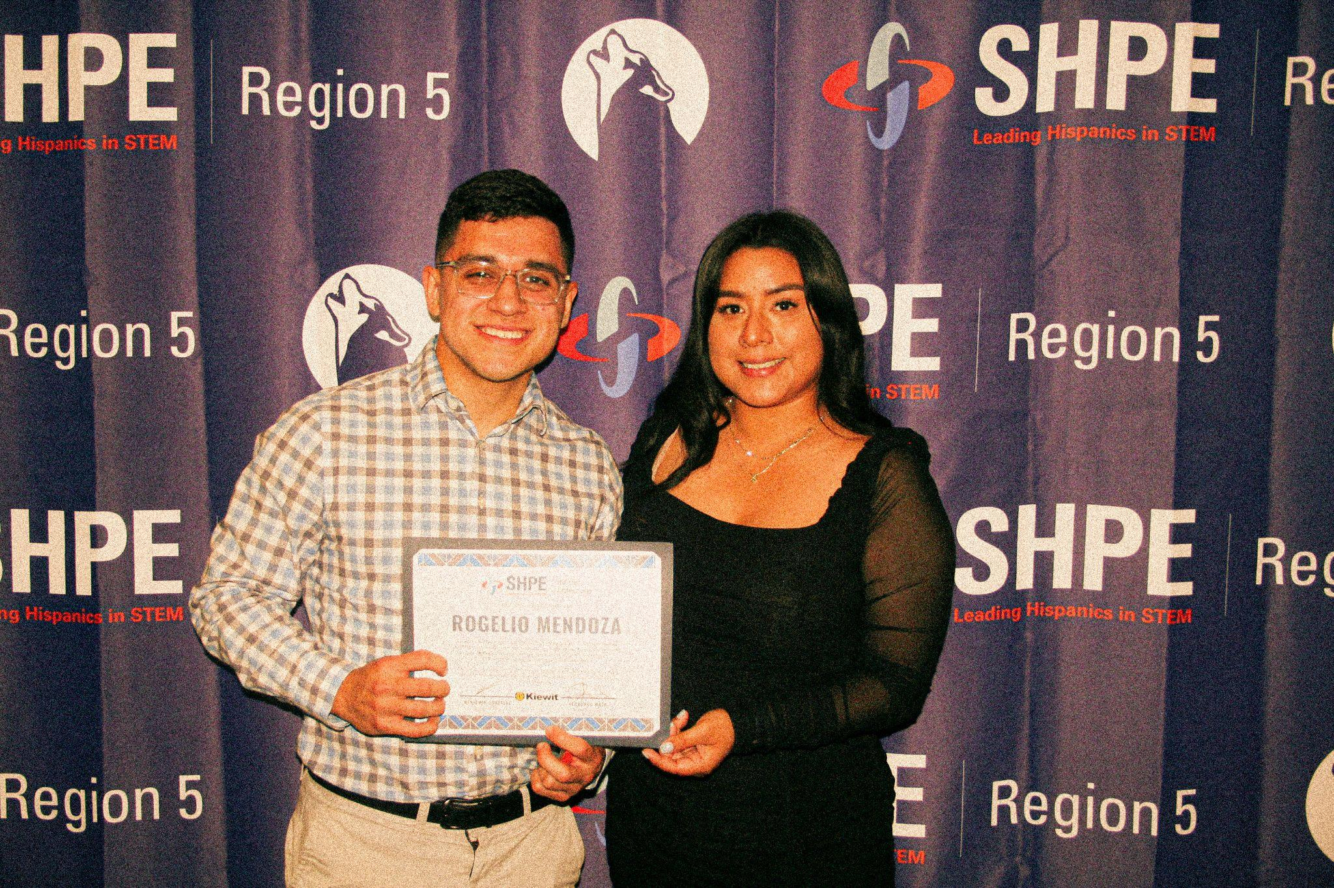
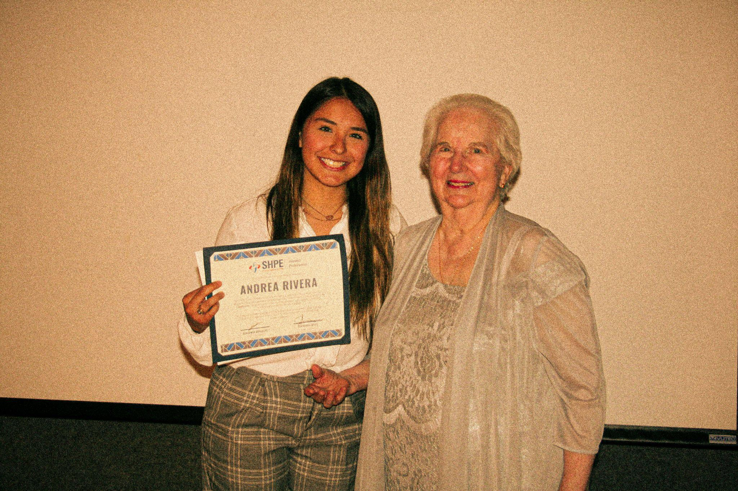
The Kiewit Corporation scholarship goes to:
Rogelio Mendoza who is a senior at University of Texas at Austin and studying mechanical engineering
Congratulations to Andrea Rivera who will be awarded the Chappelear Scholarship for being the top female applicant this year. She is a senior studying aerospace engineering at Texas A&M University

Slide 17

Stephanie Organista, a junior from the University of Houston majoring in Computer Science was a Technology Intern for AIG this Summer 2022.
Nicole Hernandez, a sophomore from the University of Houston majoring in Electrical Engineering and is currently a TA for the course ENGI 1331: Computer & Problem Solving and a piano teacher.
Gabriela Campa, a Graduate student from the University of Houston pursuing a Masters in Environmental Engineering. She is currently working part-time as an engineering intern in a local civil firm and is also studying for the Fundamentals of Engineering Exam.

Slide 18
Personal Statements

Slide 19
Telling Your Story
• Allows you to learn about yourself, more so than any other part of the
application
• Addresses any points you might not have discussed anywhere else
in the application
• It is the ONE part of the application where you are in complete
control: what you write about, and how (within given parameters)
Notes:
- Gives you an opportunity to highlight your achievements
- Provide insight into your life
- Explain difficult or outstanding circumstances
- give you an opportunity to shine

Slide 20
The Writing Process
Read and re-read the question
• Brainstorm – ask yourself questions like:
–What details of my life might help the admissions committee better
understand more about me?
–What unusual circumstances or obstacles have I overcome?
–What distinguishes me from other candidates?
–The person reading my application will have read hundreds (if not
thousands) of others. Does my essay have repeated clichés or overused
phrases?
–After all these edits, does this still sound like me to people that
know me?
Notes:
Be yourself, not the ideal applicant
Use simple language
Provide the reader with insight into what drives you
Turn negative experiences into positives
Proofred carefully

Slide 21
When Writing, DO NOT
Be patient and give yourself grace! Essays will take lots of revisions and take time
Ask your friends or professors!
• Write an essay based on your resume
• Write to impress
• Complain, blame or whine
• Preach to your reader
• Heavily use boring clichés phrases
• Use unconventional essay formats
• Submit supplemental materials unless they are requested
• Get the name of the school/scholarship wrong or forget to edit
• Use inappropriate word usage
• Talk about money as a motivator

Slide 22
Different Scholarship Essay Prompts
• Share an inspirational quote and its meaning to you.
• What’s the most difficult challenge you’ve ever faced? How did you handle it?
• What does being Hispanic mean to you, and how do your life experiences shape your answer?
• You have been invited to address a Joint Meeting of the United States Congress at the Capitol Building in Washington D.C. All 100 US Senators and 435 US Representatives will be in attendance. What will your speech be about?.
• If we did an online search of you 10 years from now, what would it say you had accomplished in your life and career? What else would the search reveal about you?

Slide 23
Career Goals Based Scholarship Essay Tips
Describe your academic and career goals and your plans to achieve them.
Try to be as specific as possible (avoid vague statements)
Discuss how your education will help you achieve your career goals (chronological order)
If you mention multiple goals, indicate which one you feel most strongly about
Point out solutions, not problems
Write, revise, rest, revise
I want to be a doctor. I aspire to study immunology to be able to study more about autoimmune diseases and pave a way for treatments.
To achieve my goals, I hope to obtain an undergraduate degree to enable me to apply to a competitive graduate school and perform cutting edge research.
I am most passionate about starting my own lab and mentoring others within my research field.
Growing up in an under resourced community has inspired me to make an impact back home and help solve health disparities.

Slide 24
And After Many Revisions...
“Growing up with an older sister who gave herself daily insulin injections, Type 1 Diabetes was an ordinary part of my childhood. But when she found that she also had Celiac Disease and Rheumatoid Arthritis fifteen years later, I began to see how significantly her autoimmune diseases dictated her lifestyle and how interconnected the diseases were. As her closest confidant, she shared concerns she’d hidden until we were in college, feelings of being a burden to the family, and difficult realizations about her future. Knowing that these contemplations were rooted in her physical ailment, I determined to understand and solve the immunological problems unfolding in her body. Soon after her diagnoses, I read about the gut-brain-axis research Sarkis Mazmanian had conducted at Caltech. This was the first time I learned about the microbiome and its ability to influence a person’s immune system. The ties between the gut microbiome and the immune system in Celiac disease, an immune-mediated attack of one’s own intestinal lining, clicked. Compelled to study these interactions, I narrowed my school searches to institutions that had joint microbiology and immunology programs.”

Slide 25
Recommendation Letters
• Refer to people who know you best → high school teachers, college professors, coaches
• Can be helpful to provide a resume or list of extracurriculars/accomplishments for your recommender to have for context
• Provide any background information on the scholarship and why you are applying to it
• Give your reference ample time to complete → 3 weeks is ideal
• Write a thank you note!

Slide 26
Additional Resources

Slide 27
Additional Resources for Undocumented Students
• Mexican American Legal Defense and Educational Fund
• Best Colleges
• Univision
• The Dream
• United We Dream
• Hispanic Scholarship Fund
• Scholarships for Minority Students

Slide 28


Slide 29
SHPE Houston Scholarship Application Tips
$1-2K in awards to rising high school seniors/college undergraduates studying STEM in Houston
Applications Open October 20 , 2021
Deadline is December 20th, 2021
Carefully check the instructions in each section. Some sections are for students currently in high school and some are for those in college.
Ask questions! We are here to help. If you are unsure how to fill out a section, please don’t hesitate to ask. This also helps us improve for next year
Questions? Please contact Daniela Gonzalez (scholarship@shpehouston.org)
Phone: 832-390-1776 (Text or call)
Check out our website for more resources!

Slide 30
Questions?

